Slide 1
Design and Analysis of Algorithms
Lecture 3
Instructor: Mehak Riaz Khan
Email: Mehak.riaz@kiet.edu.pk

Slide 2
Classes of Time Functions
O(1) ------------------ Constant
O(logn) ------------------ Logarithmic
O(n) ------------------ Linear
O(n^2) ------------------ Quadratic
O(n^3) ------------------ Cubic
O(2^n) ------------------ Exponential
1<logn<n<nlogn<n^2<n^3<2^n……<n^n

Slide 3
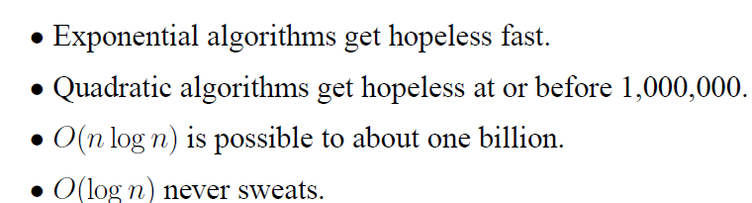
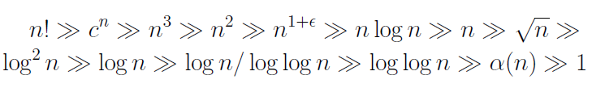
Classes of Function Comparison

Slide 4
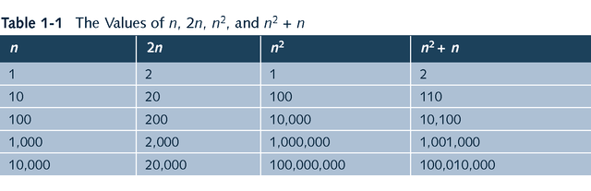
Different running times

Slide 5
Comparison Example
logn | n | n^2 | 2^n
0 | 1 | 1 | 2
1 | 2 | 4 | 4
2 | 4 | 16 | 16
3 | 8 | 64 | 256
3.1 | 9 | 81 | 512

Slide 6
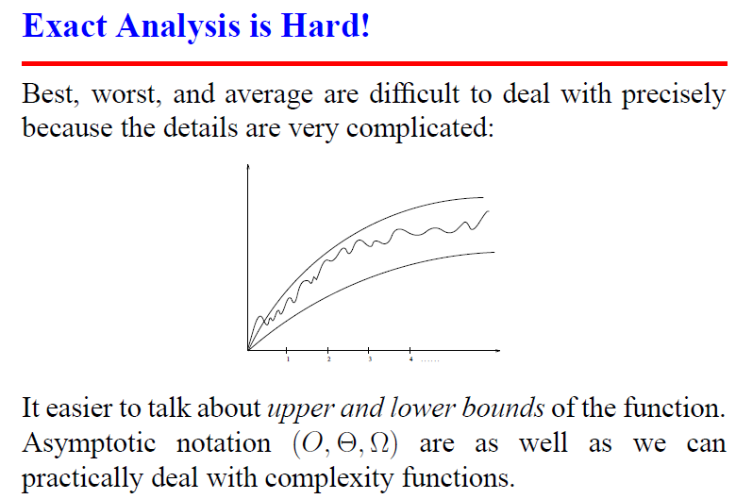
Exact Analysis is hard

Slide 7
Asymptotic Efficiency
We only look at input sizes large enough to make the order of growth of the running time relevant.

Slide 8
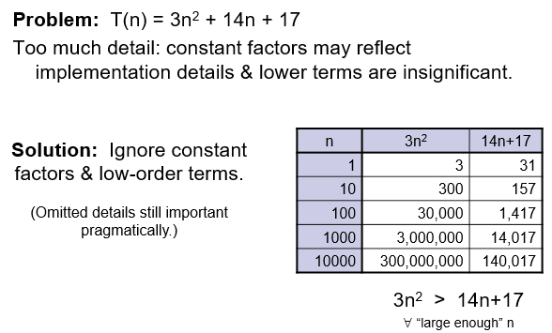
Asymptote Why?

Slide 9
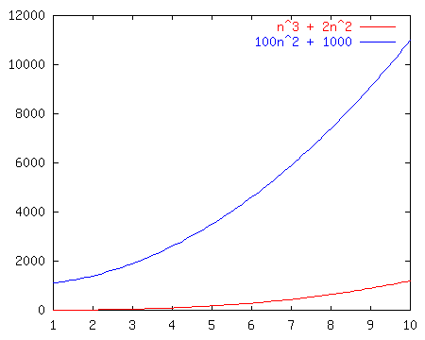
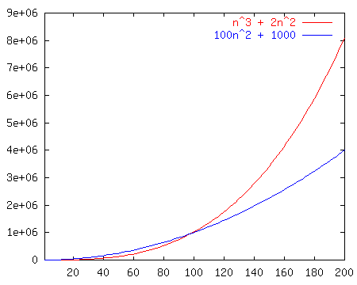
Comparison of Two Functions
n³ + 2n²
vs.
100n² + 1000

Slide 10
Growth Rates
Growth rates of functions:
Linear ≈ n
Quadratic ≈ n²
Cubic ≈ n³

Slide 11
Growth Rates
The growth rate is not affected by
constant factors or
lower-order terms
Examples
10²n + 10⁵ is a linear function
10⁵n² + 10⁸n is a quadratic function

Slide 12
Big-O Notation
Given functions f(n) and g(n), we say that f(n) is O(g(n)) if there are positive constants c>0 and n_{0>=1} such that
Formal defining function for big - O
f(n) ≤ cg(n) for n ≥ n₀
_{C = any constant > 0}
_{Like , 2, 3,4,5 etc}
n0 = last point of meeting two function on graph
_{n0= f(n)=g(n)}
_{No>1}

Slide 13
Example
1<logn<n<nlogn<n^2<n^3…..<2^n……<n^n
lower bound upper bound
tightly bound
F(n)=2n^2+3n+2 f(n)=O(n) false
2n^2+3n+2<=O(n^3) f(n)=O(n^2)
F(n)=O(2^n) f(n)=O(logn) false

Slide 14
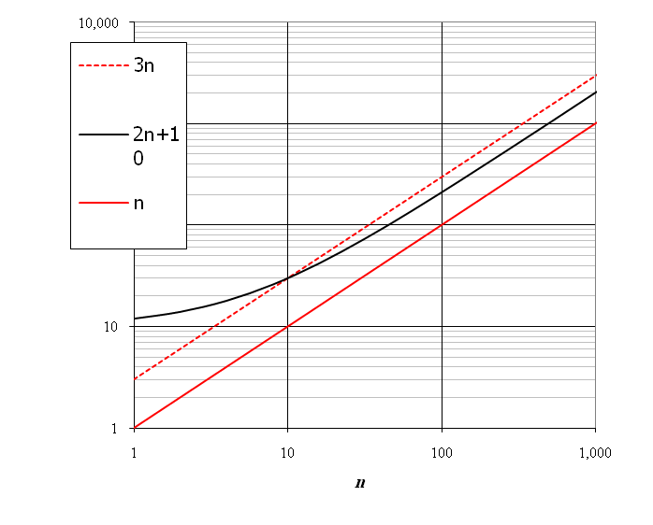
Big-O Notation
Given functions f(n) and g(n), we say that f(n) is O(g(n)) if there are positive constants c and n₀ such that
f(n) ≤ cg(n) for n ≥ n₀
Example: 2n + 10 is O(n)
2n + 10 ≤ cn
(c − 2) n ≥ 10
n ≥ 10/(c − 2)
Pick c = 3 and n₀ = 10

Slide 15
fn=2n+10
f(n)=O(n)
g(n)=n
f(n)<=Cg(n) c>0 no>=1
n=2 c=5
2(2)+10=14 > 5(2)=10
n=5 c=5
20 < 25
Didn’t get c0= f(n)=g(n) , meet point.
C=3 n=10
2(10)+10 3(10)
= 30 <- intersect
Now , from this point , g(n) always greater.

Slide 16
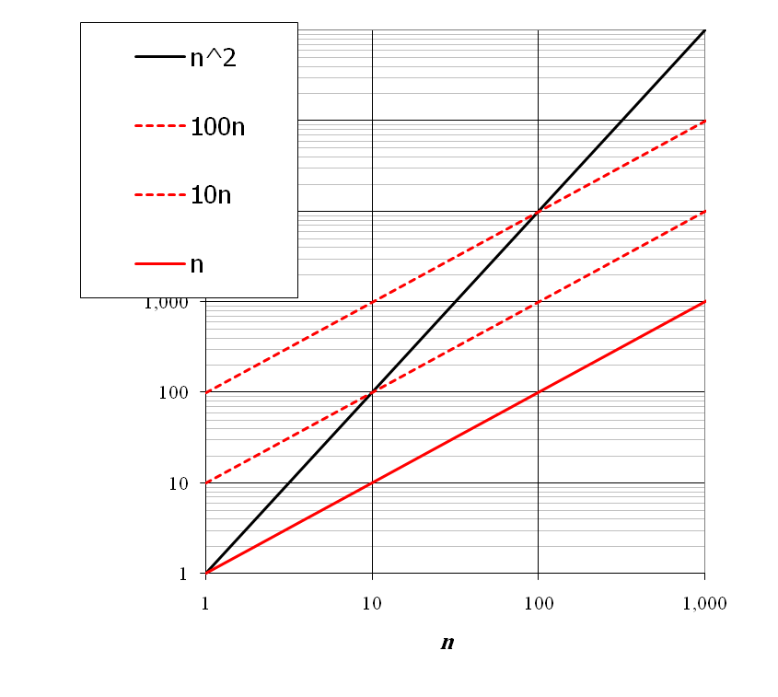
Big-O Notation
Example: the function n² is not O(n)
n² ≤ cn
n ≤ c
The above inequality cannot be satisfied since c must be a constant

Slide 17
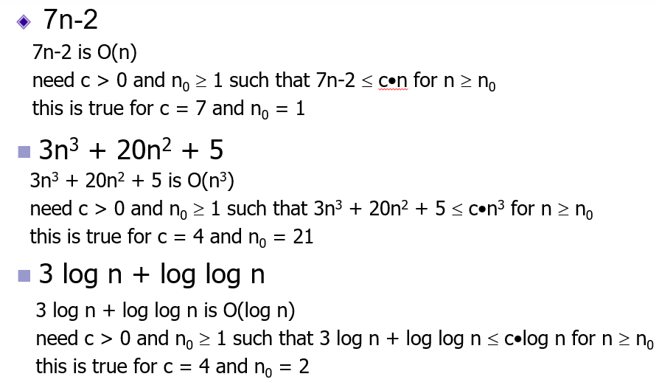
Example (O)

Slide 18
F(n)=2n^2+3n+4 g(n)=n^2
F(n)=O(g(n)) ---- false
N=2 c=3
2(4)+6+4=3(4)
18=12
N=6 , c=3
2(36)+3(6)+4=3(36)
94 =108
N=4 c=3
2(16)+3(4)+4 3(16)
48 48
N=5 , c=3
2(5)+3(5)+4 3(25)
?

Slide 19
f(n)= 2n+3
G(n)= n
Fn=O(gn)
True , false & intersect on which values ?
C=? n=?

Slide 20
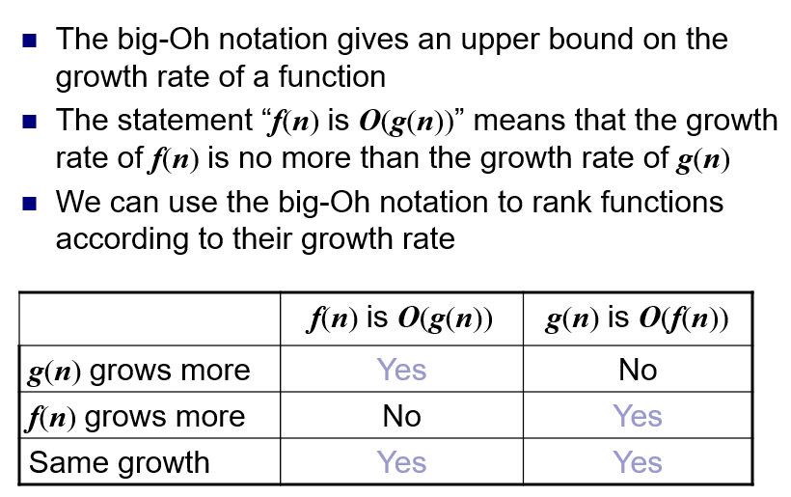
Big-O and Growth Rate

Slide 21
Omega-Ω Notation – Best case - lower bound
Given functions f(n) and g(n), we say that f(n) is Ω(g(n)) if there are positive constants c and n₀ such that
f(n) ≥ cg(n) for n ≥ n₀

Slide 22
Example
Fn=2n+5
Gn=n^2+7n+6
F(n)=Ω(gn) ----FALSE
Gn=O(fn) ----False
Gn= Ω(fn) -----true
Fn=2n^2+3n+1 gn=n
Fn= Ω(gn)

Slide 23
Theta-θ Notation – average – tightly bound
Given functions f(n) and g(n), we say that f(n) is θ(g(n)) if there are positive constants c and n₀ such that
c’•g(n) ≤ f(n) ≤ c’’•g(n) for n ≥ n0
Asymptotically tight bound

Slide 24
Fn=3n^3 +5n+7
Gn=n^3
Fn=O(gn) true
Fn= Ω(gn) true
F(n) and g(n) is same n^3 -> Omega (tightly bound)
Fn=θ(gn)
Fn=2n^2+3n+4 gn= n^2
C1n^2<= 2n^2+3n+4<=c2n^2
N=5 C1=2 c2=7
2(25)<= 2(25)+15+4 <=7(25)
50 <=69<=175

